Slide 1
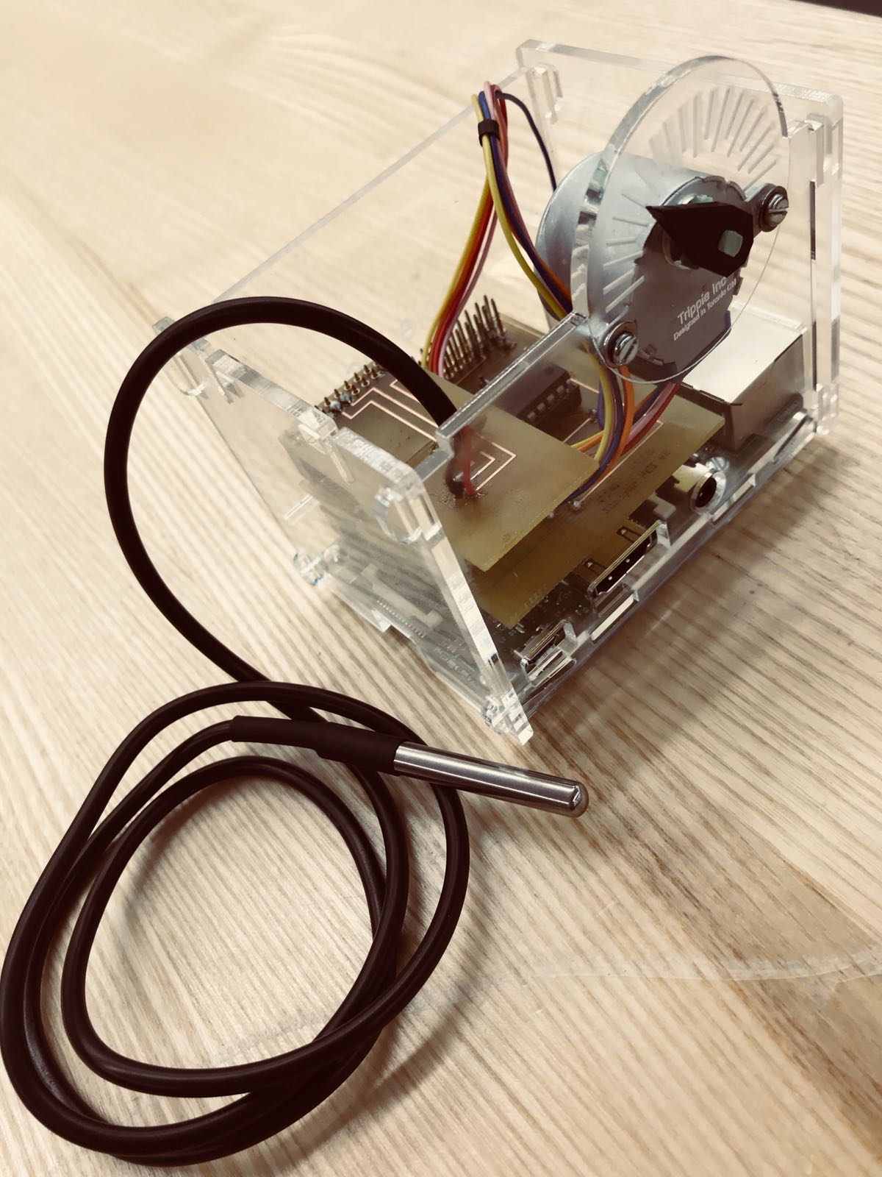

Trippie Ravneet Singh, Gaganpreet Singh Grewal & Bojan Lazic

Slide 2

Introduction [Proposal]
Application
Our Trippie is focused on solving the problems many travelers face today. Our application help users to plan out trips the best way possible.
Trippie not only suggests places to visit but also keeps a record of user’s wish-list and informs the user when would be the best time to visit that place. It doesn’t matter which place of the world you are in . Our app works everywhere. Our application also makes sure you are never lost by providing the address of user’s current location.
Hardware
The application itself is completely free to download and use. However, the user has to buy a TripPi in order to unlock an extra feature. TripPi is a Linux based machine that works on Raspberry Pi 3.0. This device senses the temperature and location which our Android application reads. This will allow users to make a better judgment of the places they want to visit before planning their trips.
🌏

Slide 3
Budget
 | Item | Source | Price (Including Taxes) | Total
1 | Raspberry Pi 3 | Amazon.com | $79.08
2 | GPS sensor, Temperature sensor and stepper motor | Amazon.com, RobotShop.com | $49.62, $16.93, $7.62
3 | PCB board | Prototype Lab | $25.50
4 | Jumper wires, Resistor | Parts Kit | $180(Partskit)
 |  |  |  | = $358.75

Slide 4
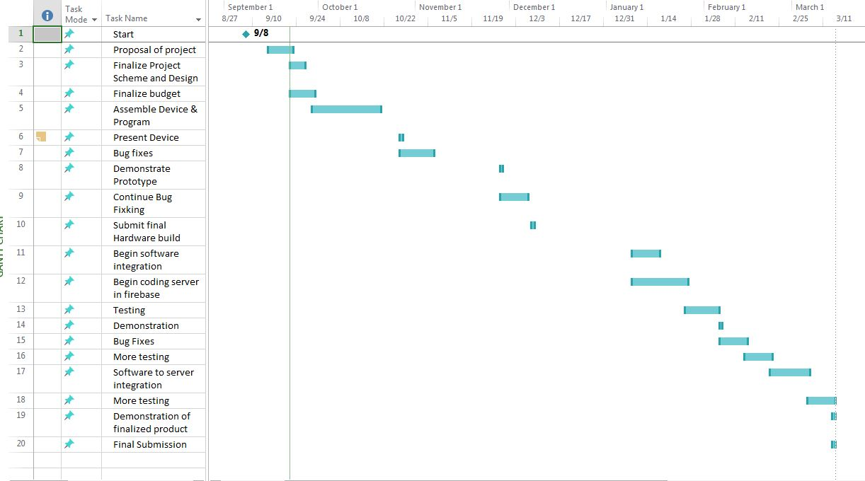
Project Schedule
January
February
March

Slide 5
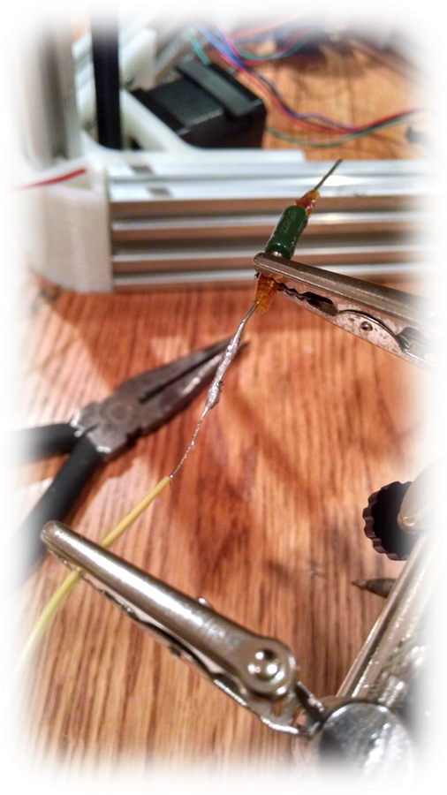
Skills in Hardware
Course of References:
Electric circuits (TECH 101) – Embedded Systems
Hardware Production Technology
Skills:
Working with Stepper Motors
Soldering and Wiring

Slide 6



Skills in Software
Course of References:
Technical C
Programming Techniques in Java
Internet Programming
Skills:
Solid Foundation in Programming and Algorithm Development
Learn how to learn (API’s)

Slide 7
Knowledge from previous Courses
TECH 153 – Technical C
- This course familiarized us with raspberry pi’s raspbian environment and how to code in it.
CENG 216 - Introduction to Software Engineering
- Learned how to build Gantt Charts.
CENG 215 – Digital and Interface Systems
CENG 319 – Software Project
- Android app development

Slide 8
Sensors & Actuators
GPS
Temperature
Stepper Motor

Slide 9
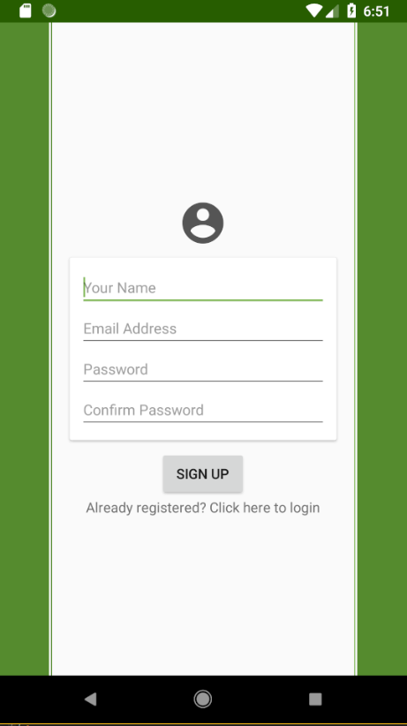
Login Page
This is Trippie’s login page.
Place your screenshot here

Slide 10
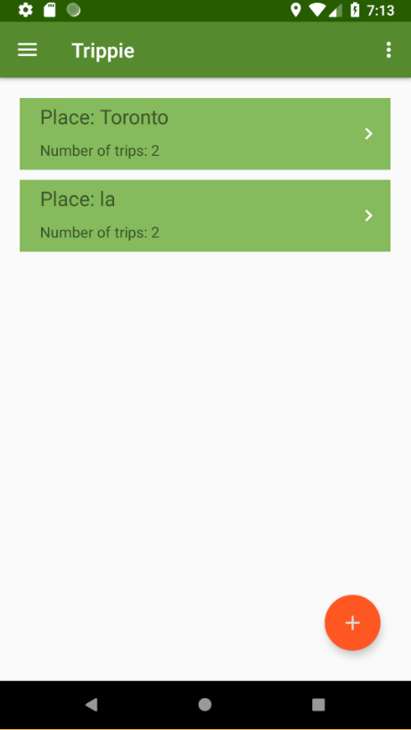
The Dashboard
This is where user controls their trips.

Slide 11
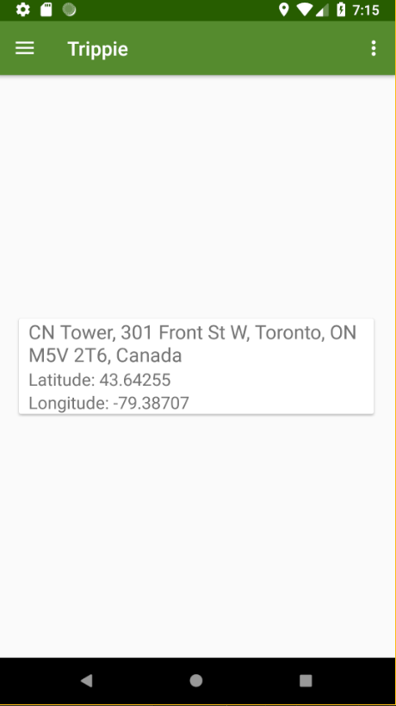
My Location
Users can always get their current location if they ever feel lost.
Place your screenshot here

Slide 12
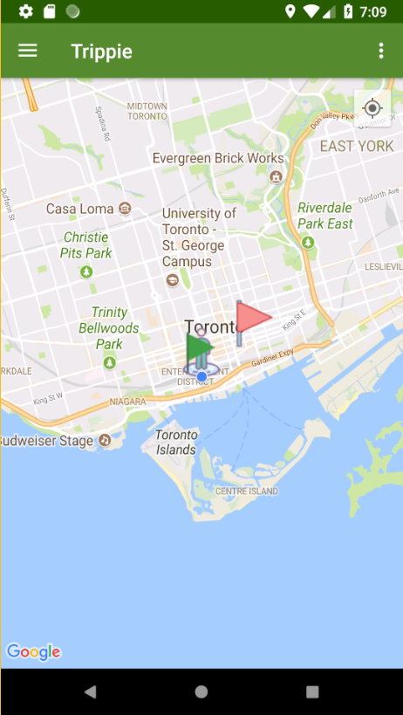
Maps
Red flags represent places yet to visit and green flags represent otherwise.

Slide 13
Add Locations Anywhere
Our Location

Slide 14
Thanks!
Any questions?

